Slide 1
Marketing and Retail Analysis of an Automobile Parts Manufacturing Company
MILESTONE-01
BIBEK KUMAR GIRI
PGP-DSBA-JULY-21

Slide 2
CONTENTS
Agenda and Executive summary of the Data
Exploratory Data analysis and Inferences
Customer Segmentation using RFM analysis
RFM Analysis and Identified segments
Recommendations

Slide 3
Problem Statement:
An automobile parts manufacturing company has collected data of transactions for 3 years. They do not have any in-house data science team, thus they have hired you as their consultant. Your job is to use your magical data science skills to provide them with suitable insights about their data and their customers.
Agenda:
The Agenda of this project is to find the underlying buying patterns of the customers from last 03 years of data from an automobile part manufacturer’s. And suggest them how and to whom they need to pay more attention so that they can plan there marketing strategies accordingly.

Slide 4
Summary of Dataset:
 | ORDERNUMBER | QUANTITY ORDERED | PRICE EACH | ORDER LINE NUMBER | SALES | DAYS SINCE LAST ORDER | MSRP
count | 2747.000000 | 2747.000000 | 2747.0000 | 2747.000000 | 2747.00 | 2747.000 | 2747.0000
mean | 10259.761558 | 35.103021 | 101.098951 | 6.491081 | 3553.0475 | 1757.085 | 100.6916
std | 91.877521 | 9.762135 | 42.042548 | 4.230544 | 1838.953 | 819.280 | 40.114802
min | 10100.000000 | 6.000000 | 26.880000 | 1.000000 | 482.1300 | 42.000 | 33.00
25% | 10181.000000 | 27.000000 | 68.745000 | 3.000000 | 2204.3500 | 1077.0000 | 68.0000
50% | 10264.000000 | 35.000000 | 95.550000 | 6.000000 | 3184.8000 | 1761.0000 | 99.000
75% | 10334.500000 | 43.000000 | 127.100000 | 9.000000 | 4503.0950 | 2436.5000 | 124.000
max | 10425.000000 | 97.000000 | 252.870000 | 18.000000 | 14082.800 | 3562.0000 | 214.0000

Slide 5
Summary Of DataSet
There are a total of 2747 entries with 20 variables.
Among the variables 01 is datetime variable, 02 are float, 05 are integers and 12 are object type variables.
There are zero null entries.
Even there are zero duplicated rows of data.
We found that MSRP is not matching with price of each item.
The product line is distributed among Classic cars, vintage cars, Motorcycles, Planes, Ships, Trains and Truck & Buses.
Order number here is different for each deal they have made.
We need to group by the data according to the customer First Name and Last Name to get a better idea of distribution of sales.

Slide 6
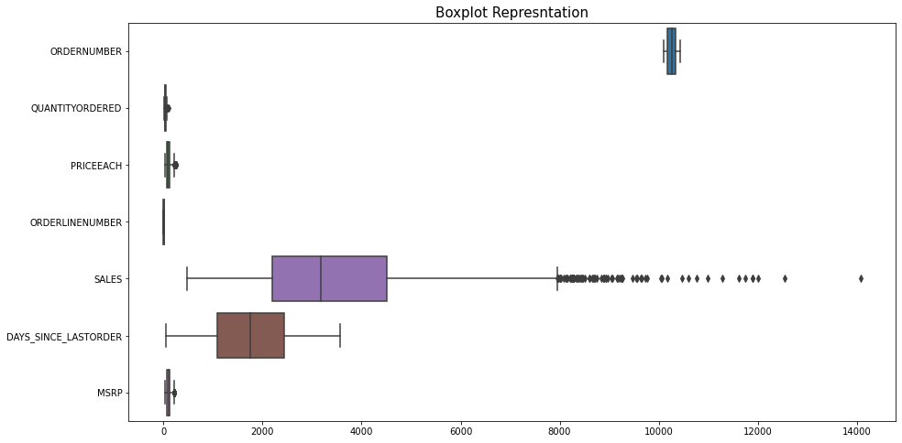
Box –Plot Representation

Slide 7
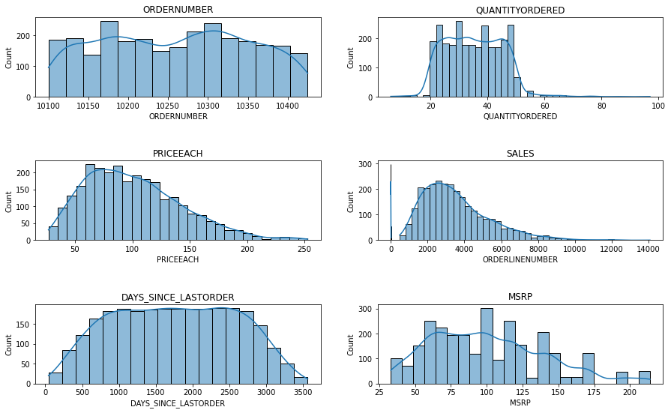
Histogram Representation

Slide 8
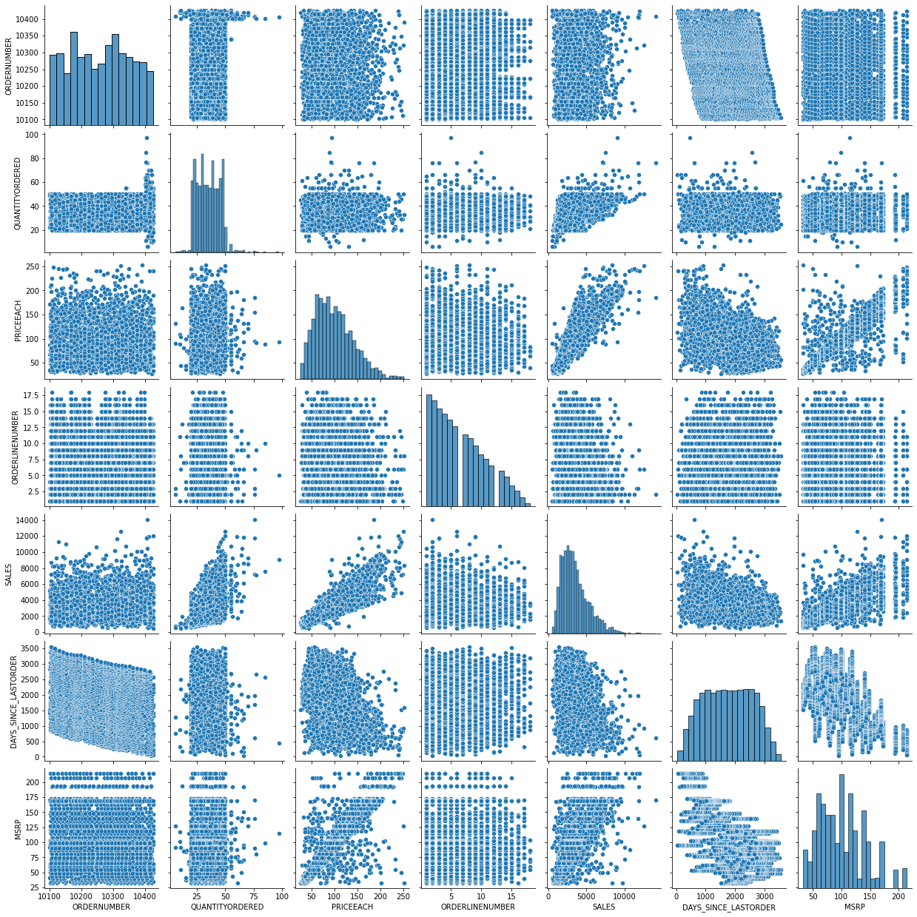
Pair-Plot Representation

Slide 9
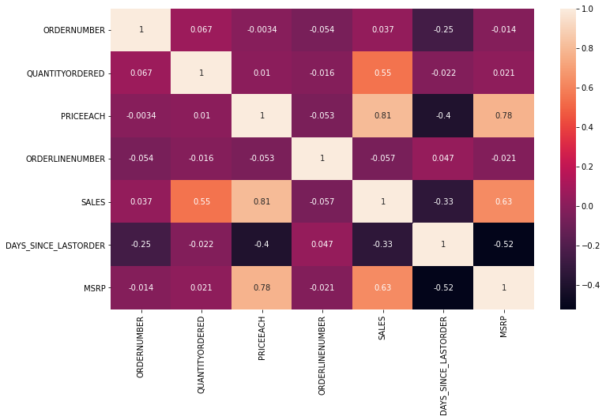
Heat-Map Representation

Slide 10
Inferences from Data
Except for Days Since last order and Order-number all other variables have outliers.
As it is the data from an automobile manufacturing company we didn’t treat the outliers as it is obvious that order quantity can be sometimes higher on basis of requirement.
From Histogram it is clear that all the numeric variables are right-skewed except for order number as it has serially updated.
From Pair-Plot and Heat map:
There little bit of relation between Price of each item and Sales.
And in quantity order and sales
Other than that there no relationship among the variables.

Slide 11
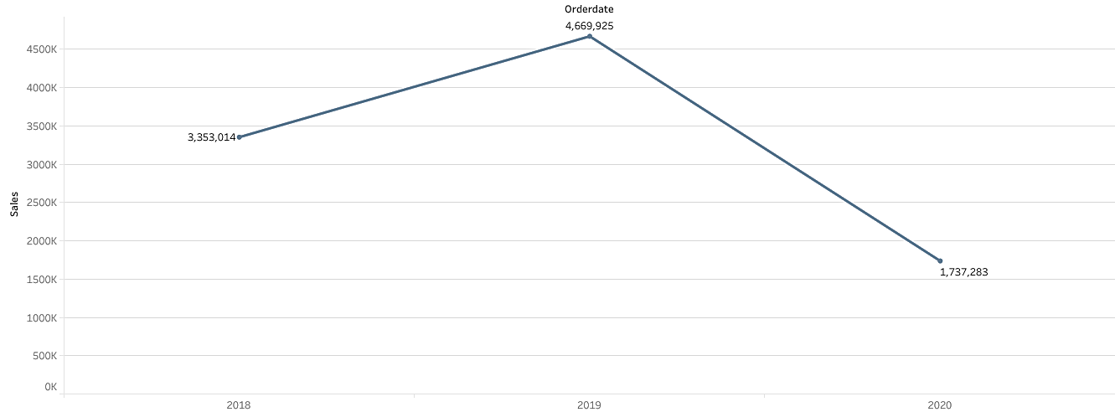
Sales across Years
There has been always up trend in the sales across the years.
There is drop in sales as only data available for 05 months as predicted from given data.

Slide 12
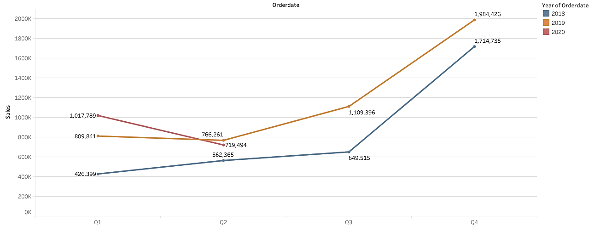
Year Vs Quarterly Sales of Items
Q4 has always shown some good margins of sales for the company among all quarters.
But in 2020 Q2, there a decline in sales.

Slide 13
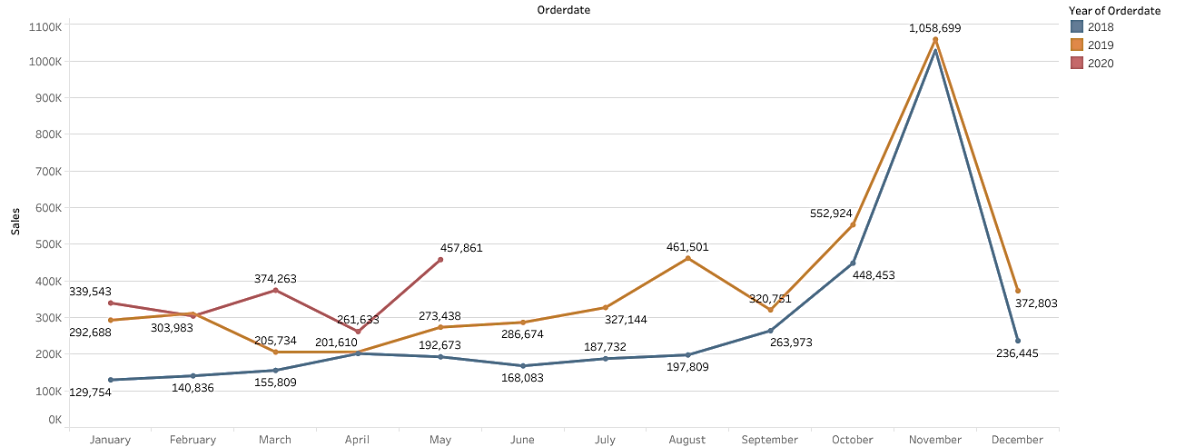
Year vs Monthly Sales of Items
Highest sales has always come in Month of November.
As predicted there is data available for first 05b months of year 2020.

Slide 14
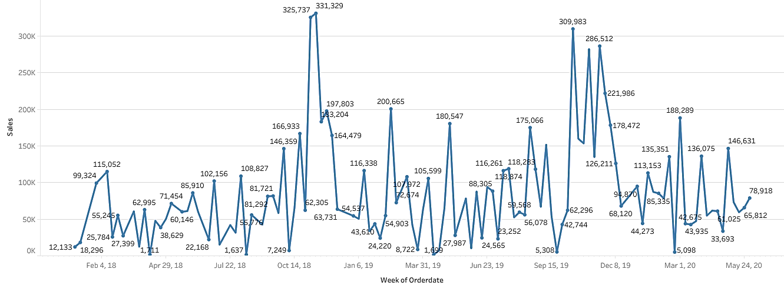
Weekly Sales Representation
We cannot tell much from weekly graph but companies weekly sales have only cross 300k mark for thrice in 2.5 years.

Slide 15
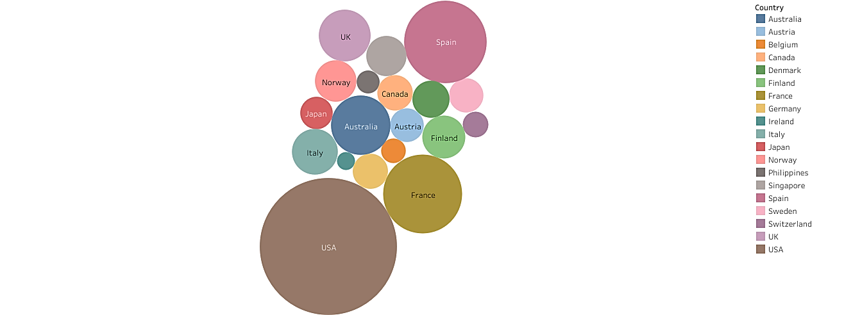
Sales of Items Across Countries
Most of orders come from USA followed by Spain and France.
Total sales in USA is 3.3million almost double of Spain sales.

Slide 16
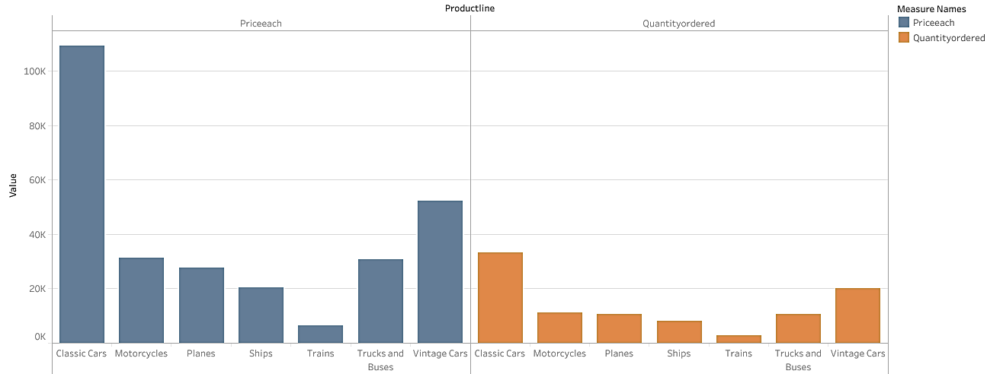
Price of Each Item vs Quantity Ordered
Looks like Price of each item is directly proportional to Quantity oof item ordered.

Slide 17
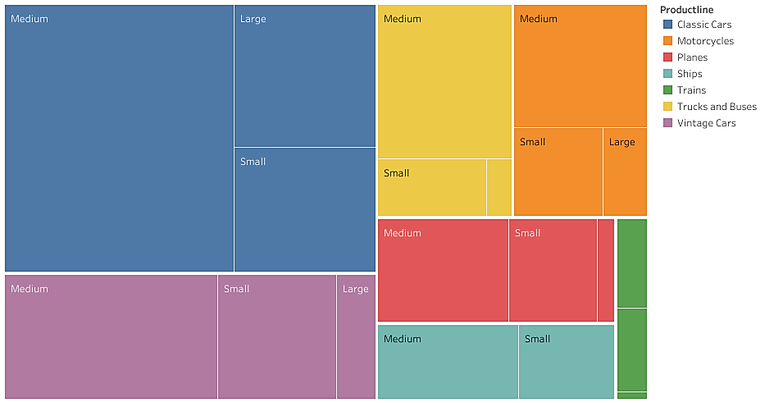
Deal-size according to Sales And Product-line
Most of deal have been made in Medium section in product line of both classic cars and vintage cars.
It is obvious that lots of people are trying to maintain their classic cars and vintage cars

Slide 18

Status of Ordered Items
Almost 93% of items have been shipped.
Cancelled ordered percentage is around 2.81%
On-hold items are 1.6% and In-process orders are under 1.5% with an dispute percentage of just over 0.5%
There status of resolving order issue is at 1.71%

Slide 19
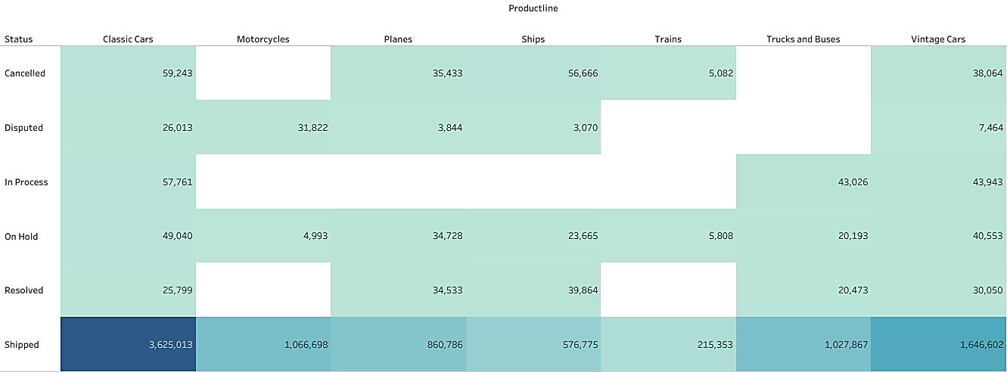
Details according to Status of Ordered Items across Product-line
It is clear from above table, the status of each product line item ordered.

Slide 20
Customer Segmentation using RFM Analysis
Customer segmentation is done by using KNIME. Workflow has shown in next slide
we have segmentate the given data on basis of How frequently they visited them, Number of times ordered, Money spend i.e, Recency, Frequency, Monetary.
The exploratory Analysis is done in Python and Tableau.
Recency: Last Ordered was placed on 31-05-2020. Hence, we have calculated by subtracting recent order to the last ordered placed i.e, 31-05-2020.
Frequency: To calculate the number of times a customer order from them we count the number of times the customer name appears on the given data set by matching Customer First name and last name.
Monetary : it is product of Quantity Ordered X PriceEach but we have consider Sales column as Monetary.
As Sales = Quantity Ordered X PriceEach.
The Recency, Frequency and Monetary has been divided into4 equal sections as 0,0.25,0.5,0.75 and 1.
Frequency and Monetary have been assigned values of 1 to 4 on basis of segmentation representing 4 as most frequent and most money spent and similarly 1 is for less frequent and less money spend.
But for Monetary the value 4 represent the most recent transactions.

Slide 21
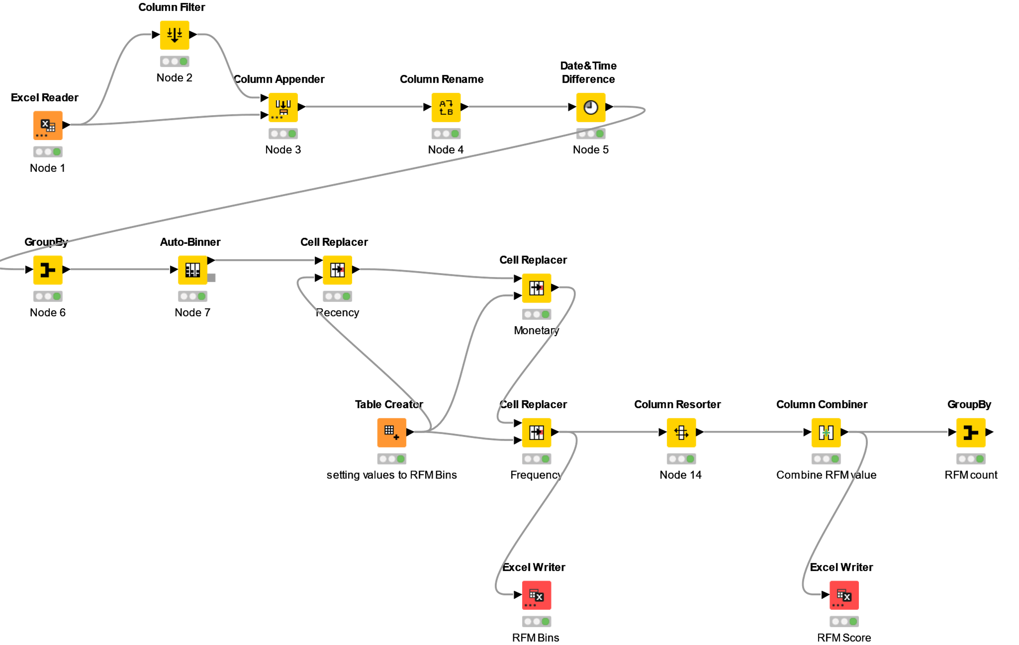
Workflow Diagram of KNIME

Slide 22
Sample Output with RFM Analysis
CONTACT LAST NAME | CONTACT FIRST NAME | SALES | ORDER NUMBER | QUANTITY ORDERED | PRICE EACH | ORDER LINE NUMBER | ORDER DATE | STATUS | PRODUCT LINE | MSRP | PRODUCT CODE | ADDRESS LINE1 | CITY | POSTAL CODE | COUNTRY | DEAL SIZE | CUSTOMER NAME | MONETARY | RECENCY | MONETARY [Binned] | CUSTOMERNAME [Binned] | RECENCY [Binned] | RECENCY_1234 | FREQUENCY_1234 | MONETARY_1234 | RFM
Accorti | Paolo | 94117.3 | 267397 | 843 | 110.85 | 7.61538462 | 2019-09-09 | Shipped | Classic Cars | 107.65 | S10_1949 | Via Monte Bianco 34 | Torino | 10100 | Italy | Large | 26 | 94117.26 | 265 | Bin 3 | Bin 2 | Bin 4 | 1 | 2 | 3 | 1,2,3
Ashworth | Victoria | 157808 | 522938 | 1778 | 91.085 | 9.01960784 | 2019-10-14 | Shipped | Classic Cars | 92.843 | S12_1108 | Fauntleroy Circus | Manchester | EC2 5NT | UK | Medium | 51 | 157807.81 | 196 | Bin 4 | Bin 4 | Bin 3 | 2 | 4 | 4 | 2,4,4
Barajas | Miguel | 57198 | 154158 | 572 | 94.681 | 7.06666667 | 2019-09-10 | Shipped | Classic Cars | 100.53 | S12_1099 | 7635 Spinnaker Dr. | Brickhaven | 58339 | USA | Large | 15 | 57197.96 | 264 | Bin 1 | Bin 1 | Bin 4 | 1 | 1 | 1 | 1,1,1
Benitez | Violeta | 98923.7 | 268417 | 903 | 109.59 | 6.23076923 | 2020-03-03 | Shipped | Motorcycles | 108 | S10_1678 | 1785 First Street | New Bedford | 50553 | USA | Medium | 26 | 98923.73 | 89 | Bin 3 | Bin 2 | Bin 2 | 3 | 2 | 3 | 3,2,3
Bennett | Helen | 78240.8 | 267544 | 895 | 88.979 | 7.96153846 | 2019-03-20 | Shipped | Classic Cars | 89.5 | S10_4757 | Garden House Crowther Way | Cowes | PO31 7PJ | UK | Medium | 26 | 78240.84 | 212 | Bin 2 | Bin 2 | Bin 3 | 2 | 2 | 2 | 2,2,2
Berglund | Christina | 75754.9 | 195784 | 647 | 119.29 | 3.15789474 | 2019-11-09 | Shipped | Classic Cars | 116 | S10_1949 | Berguvsvgen 8 | Lule | S-958 22 | Sweden | Large | 19 | 75754.88 | 194 | Bin 2 | Bin 1 | Bin 3 | 2 | 1 | 2 | 2,1,2
Sample Output with RFM Bins
CONTACTLASTNAME | CONTACTFIRSTNAME | SALES | ORDERNUMBER | QUANTITYORDERED | PRICEEACH | ORDERLINENUMBER | MONETARY | ORDERDATE | STATUS | PRODUCTLINE | MSRP | PRODUCTCODE | CUSTOMERNAME | ADDRESSLINE1 | CITY | POSTALCODE | COUNTRY | DEALSIZE | RECENCY | MONETARY [Binned] | CUSTOMERNAME [Binned] | RECENCY [Binned] | RECENCY_1234 | MONETARY_1234 | FREQUENCY_1234
Accorti | Paolo | 94117.26 | 267397 | 843 | 110.8527 | 7.615385 | 94117.26 | 2019-09-09 | Shipped | Classic Cars | 107.6538 | S10_1949 | 26 | Via Monte Bianco 34 | Torino | 10100 | Italy | Large | 265 | Bin 3 | Bin 2 | Bin 4 | 1 | 3 | 2
Ashworth | Victoria | 157807.8 | 522938 | 1778 | 91.08451 | 9.019608 | 157807.8 | 2019-10-14 | Shipped | Classic Cars | 92.84314 | S12_1108 | 51 | Fauntleroy Circus | Manchester | EC2 5NT | UK | Medium | 196 | Bin 4 | Bin 4 | Bin 3 | 2 | 4 | 4
Barajas | Miguel | 57197.96 | 154158 | 572 | 94.68067 | 7.066667 | 57197.96 | 2019-09-10 | Shipped | Classic Cars | 100.5333 | S12_1099 | 15 | 7635 Spinnaker Dr. | Brickhaven | 58339 | USA | Large | 264 | Bin 1 | Bin 1 | Bin 4 | 1 | 1 | 1
Benitez | Violeta | 98923.73 | 268417 | 903 | 109.5865 | 6.230769 | 98923.73 | 2020-03-03 | Shipped | Motorcycles | 108 | S10_1678 | 26 | 1785 First Street | New Bedford | 50553 | USA | Medium | 89 | Bin 3 | Bin 2 | Bin 2 | 3 | 3 | 2
Bennett | Helen | 78240.84 | 267544 | 895 | 88.97885 | 7.961538 | 78240.84 | 2019-03-20 | Shipped | Classic Cars | 89.5 | S10_4757 | 26 | Garden House Crowther Way | Cowes | PO31 7PJ | UK | Medium | 212 | Bin 2 | Bin 2 | Bin 3 | 2 | 2 | 2
Berglund | Christina | 75754.88 | 195784 | 647 | 119.2889 | 3.157895 | 75754.88 | 2019-11-09 | Shipped | Classic Cars | 116 | S10_1949 | 19 | Berguvsvgen 8 | Lule | S-958 22 | Sweden | Large | 194 | Bin 2 | Bin 1 | Bin 3 | 2 | 2 | 1

Slide 23
RFM Analysis and Identified Segments
1.Best Customers:
CONTACT LAST NAME | CONTACT FIRST NAME | SALES | ORDER NUMBER | QUANTITY ORDERED | PRICE EACH | ORDER LINE NUMBER | ORDER DATE | STATUS | PRODUCT LINE | MSRP | PRODUCT CODE | ADDRESS LINE1 | CITY | POSTAL CODE | COUNTRY | DEAL SIZE | CUSTOMER NAME | MONETARY | RECENCY | MONETARY [Binned] | CUSTOMERNAME [Binned] | RECENCY [Binned] | RECENCY_1234 | FREQUENCY_1234 | MONETARY_1234 | RFM
Labrune | Janine | 180125 | 548305 | 1832 | 97.046 | 7.73584906 | 2019-10-29 | Shipped | Motorcycles | 96.151 | S10_1678 | 67, rue des Cinquante Otages | Nantes | 44000 | France | Medium | 53 | 180124.9 | 0 | Bin 4 | Bin 4 | Bin 1 | 4 | 4 | 4 | 4,4,4
Freyre | Diego | 912294 | 2666218 | 9327 | 97.383 | 6.42471042 | 2020-03-01 | Disputed | Motorcycles | 97.015 | S10_1678 | C/ Moralzarzal, 86 | Madrid | 28034 | Spain | Large | 259 | 912294.11 | 0 | Bin 4 | Bin 4 | Bin 1 | 4 | 4 | 4 | 4,4,4
Yu | Kyung | 122138 | 319272 | 1111 | 108.57 | 5.61290323 | 2019-11-02 | Shipped | Motorcycles | 106.58 | S10_1678 | 7586 Pompton St. | Allentown | 70267 | USA | Medium | 31 | 122138.14 | 1 | Bin 4 | Bin 3 | Bin 1 | 4 | 3 | 4 | 4,3,4
Huxley | Adrian | 151571 | 474596 | 1601 | 95.189 | 6.47826087 | 2019-12-17 | Shipped | Motorcycles | 93.087 | S10_1678 | Monitor Money Building, 815 Pacific Hwy | Chatswood | 2067 | Australia | Small | 46 | 151570.98 | 2 | Bin 4 | Bin 4 | Bin 1 | 4 | 4 | 4 | 4,4,4
Nelson | Valarie | 654858 | 1850123 | 6366 | 102.7 | 7.16666667 | 2018-08-08 | Shipped | Classic Cars | 102.51 | S10_1949 | 5677 Strong St. | San Rafael | 97562 | USA | Large | 180 | 654858.06 | 2 | Bin 4 | Bin 4 | Bin 1 | 4 | 4 | 4 | 4,4,4
Pipps | Georg | 149799 | 411480 | 1442 | 101.4 | 6.7 | 2018-04-28 | Shipped | Motorcycles | 102.93 | S10_1678 | Geislweg 14 | Salzburg | 5020 | Austria | Large | 40 | 149798.63 | 14 | Bin 4 | Bin 4 | Bin 1 | 4 | 4 | 4 | 4,4,4
This group consists of those customers who have transacted recently, do so often and spend more than other customers.
A shortened notation for this segment is 4-4-4 or 4-3-4 we’ll use this notation going forward.

Slide 24
2.Customers on verge of churning:
CONTACT LAST NAME | CONTACT FIRST NAME | SALES | ORDER NUMBER | QUANTITY ORDERED | PRICE EACH | ORDER LINE NUMBER | ORDER DATE | STATUS | PRODUCT LINE | MSRP | PRODUCT CODE | ADDRESS LINE1 | CITY | POSTAL CODE | COUNTRY | DEAL SIZE | CUSTOMER NAME | MONETARY | RECENCY | MONETARY [Binned] | CUSTOMERNAME [Binned] | RECENCY [Binned] | RECENCY_1234 | FREQUENCY_1234 | MONETARY_1234 | RFM
Saveley | Mary | 142874 | 418659 | 1428 | 100.55 | 7.46341463 | 2019-01-02 | Shipped | Classic Cars | 102.02 | S10_1949 | 2, rue du Commerce | Lyon | 69004 | France | Large | 41 | 142874.25 | 456 | Bin 4 | Bin 4 | Bin 4 | 1 | 4 | 4 | 1,4,4
Holz | Michael | 117714 | 318029 | 1078 | 112.08 | 8.32258065 | 2019-08-30 | Shipped | Classic Cars | 115.58 | S12_1099 | Grenzacherweg 237 | Gensve | 1203 | Switzerland | Medium | 31 | 117713.56 | 275 | Bin 3 | Bin 3 | Bin 4 | 1 | 3 | 3 | 1,3,3
Oeztan | Veysel | 111640 | 295737 | 973 | 113.56 | 6.86206897 | 2018-11-18 | Shipped | Motorcycles | 109.76 | S10_1678 | Drammen 121, PR 744 Sentrum | Bergen | N 5804 | Norway | Medium | 29 | 111640.28 | 271 | Bin 3 | Bin 3 | Bin 4 | 1 | 3 | 3 | 1,3,3
Accorti | Paolo | 94117.3 | 267397 | 843 | 110.85 | 7.61538462 | 2019-09-09 | Shipped | Classic Cars | 107.65 | S10_1949 | Via Monte Bianco 34 | Torino | 10100 | Italy | Large | 26 | 94117.26 | 265 | Bin 3 | Bin 2 | Bin 4 | 1 | 2 | 3 | 1,2,3
Hernandez | Marta | 103080 | 277975 | 976 | 107.07 | 7.25925926 | 2019-08-27 | Shipped | Motorcycles | 104.26 | S10_1678 | 39323 Spinnaker Dr. | Cambridge | 51247 | USA | Medium | 27 | 103080.38 | 231 | Bin 3 | Bin 3 | Bin 4 | 1 | 3 | 3 | 1,3,3
On basis on Recency, frequency & monetary we have grouped our Customers who are on verge of churning. We should definitely focus on this group before we lose them and try to convert them into our regular customers.
Their frequency is good with good monetary value, but low recency made them stand in this group. If the company pays more attention and fulfil their requirement, then we can easily turn them into our regular customer and we can save them from churning out.

Slide 25
3.Lost Customers:
CONTACT LAST NAME | CONTACT FIRST NAME | SALES | ORDER NUMBER | QUANTITY ORDERED | PRICE EACH | ORDER LINE NUMBER | ORDER DATE | STATUS | PRODUCT LINE | MSRP | PRODUCT CODE | ADDRESS LINE1 | CITY | POSTAL CODE | COUNTRY | DEAL SIZE | CUSTOMER NAME | MONETARY | RECENCY | MONETARY [Binned] | CUSTOMERNAME [Binned] | RECENCY [Binned] | RECENCY_1234 | FREQUENCY_1234 | MONETARY_1234 | RFM
Hardy | Thomas | 36019 | 122313 | 357 | 99.108 | 4.25 | 2018-11-14 | Shipped | Classic Cars | 93.25 | S10_4757 | 120 Hanover Sq. | London | WA1 1DP | UK | Medium | 12 | 36019.04 | 495 | Bin 1 | Bin 1 | Bin 4 | 1 | 1 | 1 | 1,1,1
Thompson | Steve | 46084.6 | 132747 | 511 | 88.308 | 4.69230769 | 2018-12-01 | Shipped | Classic Cars | 93.231 | S10_1949 | 3675 Furth Circle | Burbank | 94019 | USA | Medium | 13 | 46084.64 | 488 | Bin 1 | Bin 1 | Bin 4 | 1 | 1 | 1 | 1,1,1
Taylor | Sue | 50218.5 | 152515 | 514 | 95.396 | 5.06666667 | 2019-02-10 | Shipped | Trucks and Buses | 90.933 | S12_4473 | 2793 Furth Circle | Brisbane | 94217 | USA | Medium | 15 | 50218.51 | 476 | Bin 1 | Bin 1 | Bin 4 | 1 | 1 | 1 | 1,1,1
Rance | Martine | 69052.4 | 203864 | 699 | 95.474 | 6.3 | 2019-02-21 | Shipped | Motorcycles | 94.5 | S10_1678 | 184, chausse de Tournai | Lille | 59000 | France | Small | 20 | 69052.41 | 465 | Bin 1 | Bin 1 | Bin 4 | 1 | 1 | 1 | 1,1,1
Fernandez | Jesus | 49642.1 | 132409 | 468 | 104.96 | 5.30769231 | 2018-11-07 | Shipped | Classic Cars | 106.92 | S12_1108 | Merchants House, 27-30 Merchant's Quay | Madrid | 28023 | Spain | Large | 13 | 49642.05 | 439 | Bin 1 | Bin 1 | Bin 4 | 1 | 1 | 1 | 1,1,1
Kentary | Mory | 67605.1 | 204290 | 692 | 99.914 | 7.95 | 2019-01-12 | Shipped | Motorcycles | 101.65 | S10_2016 | Dojima Avanza 4F, 1-6-20 Dojima, Kita-ku | Osaka | 530-0003 | Japan | Medium | 20 | 67605.07 | 414 | Bin 1 | Bin 1 | Bin 4 | 1 | 1 | 1 | 1,1,1
Tseng | Kyung | 36163.6 | 112613 | 357 | 101.33 | 3.27272727 | 2019-05-08 | Shipped | Classic Cars | 97.364 | S10_1949 | 4658 Baden Av. | Cambridge | 51247 | USA | Medium | 11 | 36163.62 | 389 | Bin 1 | Bin 1 | Bin 4 | 1 | 1 | 1 | 1,1,1
On basis on Recency, frequency & monetary parameters we have grouped our Customers who we’d lost. Their recency is very low and hasn’t made any purchase since long and they very low on frequency too. So we can say these are our lost customers.
If taken feedback from them and fulfill their demand we might bring them back to been a good customer.

Slide 26
4.Loyal Customers:
CONTACT LAST NAME | CONTACT FIRST NAME | SALES | ORDER NUMBER | QUANTITY ORDERED | PRICE EACH | ORDER LINE NUMBER | ORDER DATE | STATUS | PRODUCT LINE | MSRP | PRODUCT CODE | ADDRESS LINE1 | CITY | POSTAL CODE | COUNTRY | DEAL SIZE | CUSTOMER NAME | MONETARY | RECENCY | MONETARY [Binned] | CUSTOMERNAME [Binned] | RECENCY [Binned] | RECENCY_1234 | FREQUENCY_1234 | MONETARY_1234 | RFM
Yu | Kyung | 122138 | 319272 | 1111 | 108.57 | 5.61290323 | 2019-11-02 | Shipped | Motorcycles | 106.58 | S10_1678 | 7586 Pompton St. | Allentown | 70267 | USA | Medium | 31 | 122138.14 | 1 | Bin 4 | Bin 3 | Bin 1 | 4 | 3 | 4 | 4,3,4
Victorino | Wendy | 115499 | 369736 | 1236 | 95.593 | 6.30555556 | 2019-02-04 | Shipped | Classic Cars | 97.222 | S10_4962 | Village Close - 106 Linden Road Sandown | Singapore | 69045 | Singapore | Large | 36 | 115498.73 | 38 | Bin 3 | Bin 4 | Bin 1 | 4 | 4 | 3 | 4,4,3
Shimamura | Akiko | 120563 | 330728 | 1150 | 101.18 | 6.34375 | 2019-11-23 | Shipped | Classic Cars | 99.281 | S10_1949 | 2-2-8 Roppongi | Minato-ku | 106-0032 | Japan | Large | 32 | 120562.74 | 39 | Bin 3 | Bin 3 | Bin 1 | 4 | 3 | 3 | 4,3,3
Devon | Elizabeth | 118008 | 298981 | 1046 | 108.54 | 5.89655172 | 2020-04-08 | Shipped | Motorcycles | 110.28 | S10_1678 | Berkeley Gardens 12 Brewery | Liverpool | WX1 6LT | UK | Small | 29 | 118008.27 | 53 | Bin 3 | Bin 3 | Bin 1 | 4 | 3 | 3 | 4,3,3
Perrier | Dominique | 93170.7 | 276639 | 1001 | 94.255 | 6.33333333 | 2019-05-26 | Shipped | Motorcycles | 94.852 | S10_1678 | 25, rue Lauriston | Paris | 75016 | France | Medium | 27 | 93170.66 | 54 | Bin 3 | Bin 3 | Bin 1 | 4 | 3 | 3 | 4,3,3
On basis on Recency, frequency & monetary we have grouped our loyal customers. These customers have purchased multiple times with good monetary value. If we focus more on this segment of customers, we can easily turn them into out top best customers too.

Slide 27
Recommendations
Using Recency, frequency & monetary parameters or RFM score we have grouped our top , loyal, on the verge of churning and lost customers. Customers with good recency, frequency and monetary has been our top customers were as we also have lost customer lists.
Customers on verge of churning can be saved and can be converted into a good buyer. These are valuable customers who stopped transacting a long time ago. While it’s often challenging to re-engage churned customers, but they are high value of these customers. It’s important to communicate with them to know there preferences. It is vital for the company to convert the customers who are on verge of churning into a regular customer or at-least maintain them.
Recency, frequency & monetary parameters were widely used to divide the types of customers.
This model can be very helpful to the company to maintain its sales and customers and can focus on how the company has lost the customers & can take various actions to bring back them.
These customers can be called as Repeat customers who are active and loyal, but they are low spenders. Company should create campaigns for this group that make them feel valued, and incentivize them to increase their spend levels by offering some coupons or discounts.
And also how to increase the sales ratio can be identified.

